Slide 2
Topics
Basic String Operations
Various String Functions – Slicing, Testing, Searching, and Manipulating Strings

Slide 3
Accessing the Individual Characters in a String
To access an individual character in a string:
  Use a for loop
    Format: for character in string:
  Use a for loop with indexing
    Each character has an index specifying its position in the string, starting at 0

Slide 4
Accessing the Individual Characters in a String
name = 'Manhattan'
# Without using indexing
for ch in name:
print(ch)
# Using indexing
for i in range(len(name)):
print(name[i])

Slide 5
Accessing the Individual Characters in a String
IndexError exception will occur if:
  You try to use an index that is out of range for the string
    Likely to happen when loop iterates beyond the end of the string
len(string) function can be used to obtain the length of a string
  Useful to prevent loops from iterating beyond the end of a string

Slide 6
String Concatenation
Concatenation: appending one string to the end of another string
  Use the + operator to produce a string that is a combination of its operands
  The augmented assignment operator += can also be used to concatenate strings
    The operand on the left side of the += operator must be an existing variable; otherwise, an exception is raised
first_name = 'Emily'
last_name = 'Blunt'
name = first_name + ' ' + last_name
print(name)

Slide 7
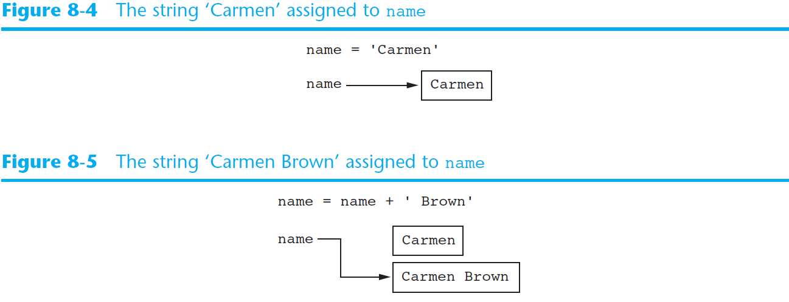
Strings Are Immutable
Strings are immutable
  Once they are created, they cannot be changed

Slide 8
String Slicing
Slice: span of items taken from a sequence, known as substring
  Slicing format: string[start : end]
    Expression will return a string containing a copy of the characters from start up to, but not including, end
    If start not specified, 0 is used for start index
    If end not specified, len(string) is used for end index

Slide 9
String Slicing
full_name = 'Patty Lynn Smith’
# Print the middle name
print (full_name[6:10])
# Print the first name
print(full_name[:5])
# Print the last name
print(full_name[11:])

Slide 10
String Slicing
Slicing expressions can include a step value
Slicing expressions can include negative indexes relative to end of string
# The slice here contains every second character
letters = 'ABCDEFGHIJKLMNOPQRSTUVWXYZ'
print(letters[0:26:2])
full_name = 'Patty Lynn Smith'
# Print the last name
print(full_name[-5:])

Slide 11
Testing Strings with in and not in
You can use the in operator to determine whether one string is contained in another string
  General format: string1 in string2
Similarly, you can use the not in operator to determine whether one string is not contained in another string
if '@njit.edu' in 'kmq2@njit.edu':
print('The email is affiliated to NJIT.')
else:
print('The email is not affiliated to NJIT.')

Slide 12
String Methods
Strings in Python have numerous methods
  General format: stringvar.method(arguments)

Slide 13
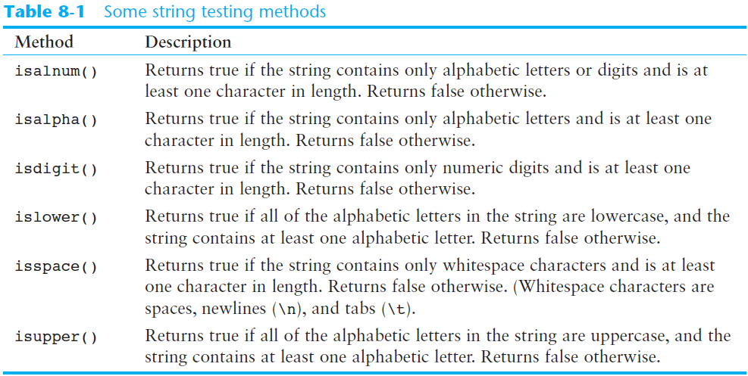
Some String Testing Methods

Slide 14
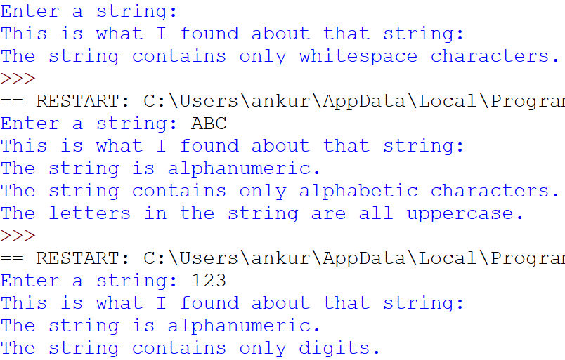
Some String Testing Methods
# This program demonstrates several string testing methods.
def main():
# Get a string from the user.
user_string = input('Enter a string: ')
print('This is what I found about that string:')
# Test the string.
if user_string.isalnum():
print('The string is alphanumeric.')
if user_string.isdigit():
print('The string contains only digits.')
if user_string.isalpha():
print('The string contains only alphabetic characters.')
if user_string.isspace():
print('The string contains only whitespace characters.')
if user_string.islower():
print('The letters in the string are all lowercase.')
if user_string.isupper():
print('The letters in the string are all uppercase.')
# Call the main function.
if __name__ == '__main__':
main()

Slide 15
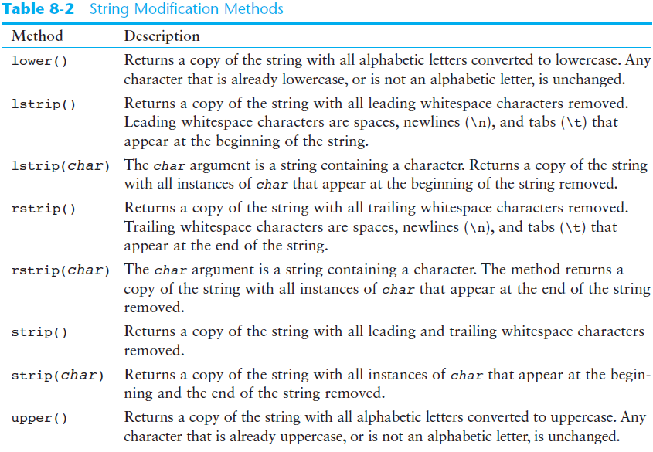
String Modification Methods

Slide 16
String Modification Methods
s = ' nyc '
s = s.strip()
s = s.upper()
print(s)

Slide 17
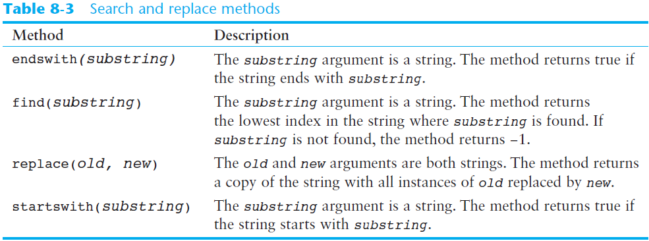
String Searching and Replacing Methods

Slide 18
String Searching and Replacing Methods
filename = input('Enter the filename: ')
if filename.endswith('.txt'):
print('That is the name of a text file.')
elif filename.endswith('.py'):
print('That is the name of a Python source file.')
else:
print('Unknown file type.')
string = 'manhattan college is not in manhattan.'
new_string = string.replace('manhattan', 'Manhattan')
print(new_string)
email = 'kmq2@njit.edu'
if email.find('@') != -1:
print('"@" was found.')
else:
print('"@" was not found.')

Slide 19
The Repetition Operator
Repetition operator (*): makes multiple copies of a string and joins them together
  General format: string_to_copy * n
  Variable references a new string which contains multiple copies of the original string
Example: print(‘#’ * 20)
  The above prints: ####################

Slide 20
Splitting a String
split method: returns a list containing the words in the string
  By default, uses space as separator
  Can specify a different separator by passing it as an argument to the split method
print('Maria Vella'.split()) # ['Maria', 'Vella’]
date ='02/23/2023'.split('/')
print(date) # ['02', '23', '2023']
print(f'Month: {date[0]}') # Month: 02
print(f'Day: {date[1]}') # Day: 23
print(f'Year: {date[2]}') # Year: 2023

Slide 21
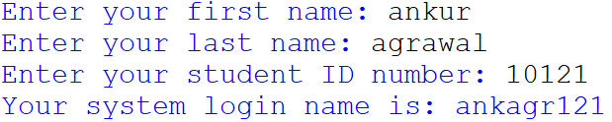
Exercise
Write a program that generates system login names for students. You will use the following algorithm to generate a login name:
Get the first three characters of the student’s first name. (If the first name is less than three characters in length, use the entire first name.)
Get the first three characters of the student’s last name. (If the last name is less than three characters in length, use the entire last name.)
Get the last three characters of the student’s ID number. (If the ID number is less than three characters in length, use the entire ID number.)
Concatenate the three sets of characters to generate the login name.
For example, if a student’s name is Amanda Spencer, and her ID number is CMPT6721, her login name would be AmaSpe721.

Slide 22
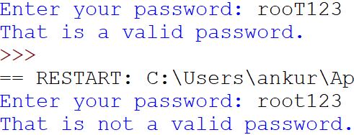
Exercise
Write a program that asks the user for a password and validates it based on the following criteria:
  The password must be at least seven characters long.
  It must contain at least one uppercase letter.
  It must contain at least one lowercase letter.
  It must contain at least one numeric digit.

Slide 23
Summary
This chapter covered:
  String operations, including:
    Methods for iterating over strings
    Repetition and concatenation operators
    Strings as immutable objects
    Slicing strings and testing strings
    String methods
    Splitting a string

